Slide 1
Topic Modeling
อ. ดร.อรรถพล ธำรงรัตนฤทธิ์
DAT03 - Day 6

Slide 2
Summarizing Document Collection

Slide 3
Machine Learning x NLP
Machine Learning is an algorithm that allows computers to learn from data
Supervised learning - input and output (labels) must be provided
Unsupervised learning - sorting data into groups

Slide 4
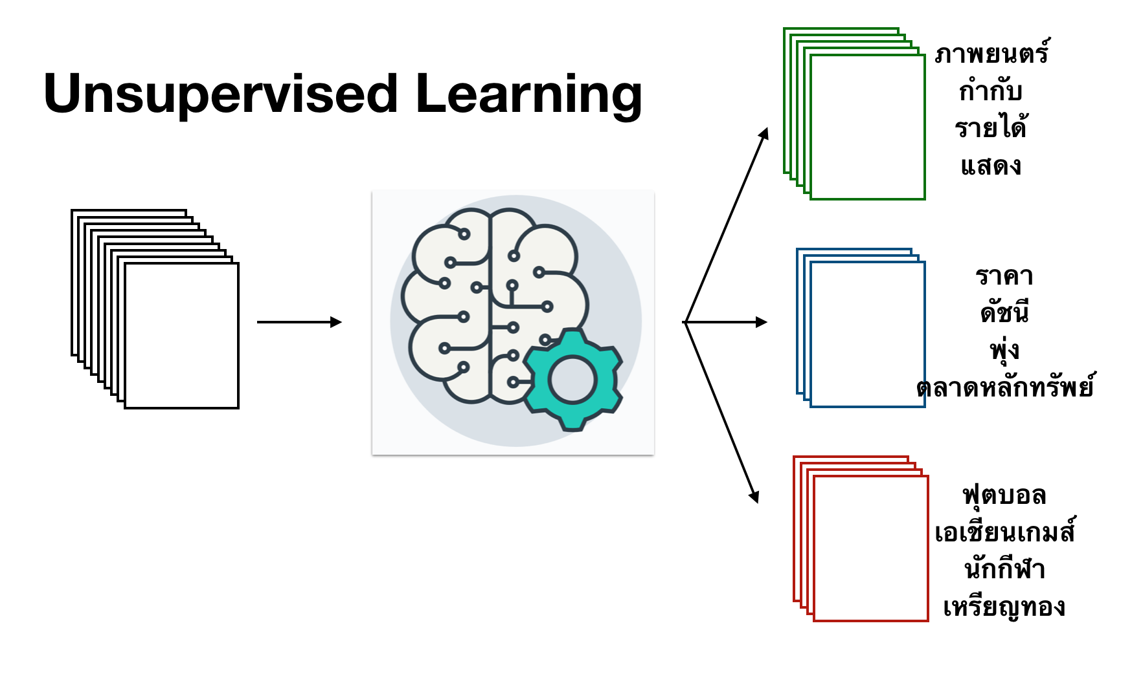

Slide 5
LDA Topic Model

Slide 6
Latent Dirichlet Allocation (LDA)
A collection of documents can be summarized with a list of topics
A topic is a list of words and their frequency

Slide 7
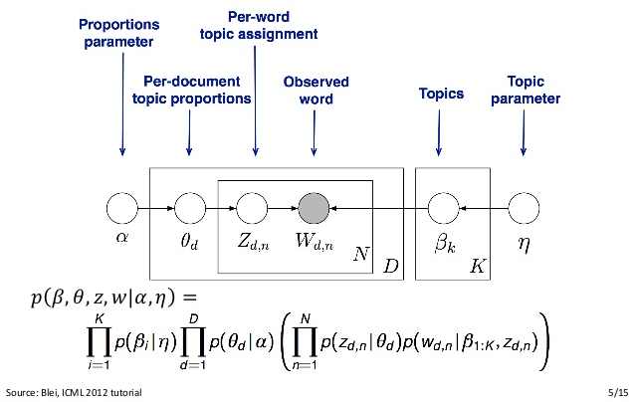
The Math of LDA takes a week to learn...

Slide 8
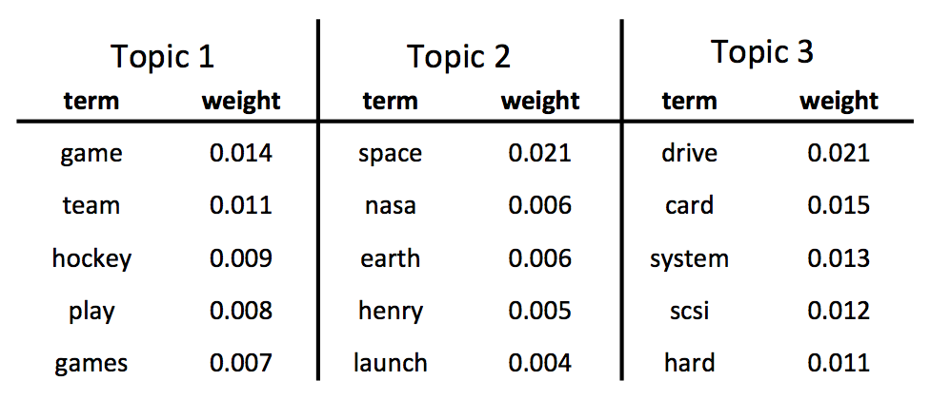
LDA Model gives a list of topics. A topic is a mixture of words sorted by their frequencies.

Slide 9
A document is a mixture of topics. A topic is a mixture of words.

Slide 10
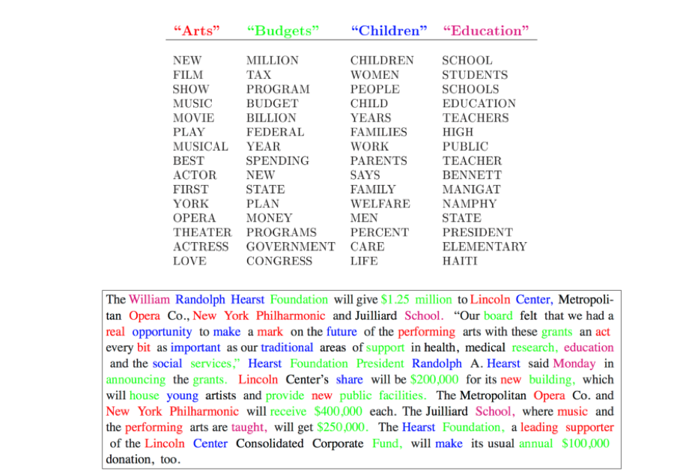

Slide 11
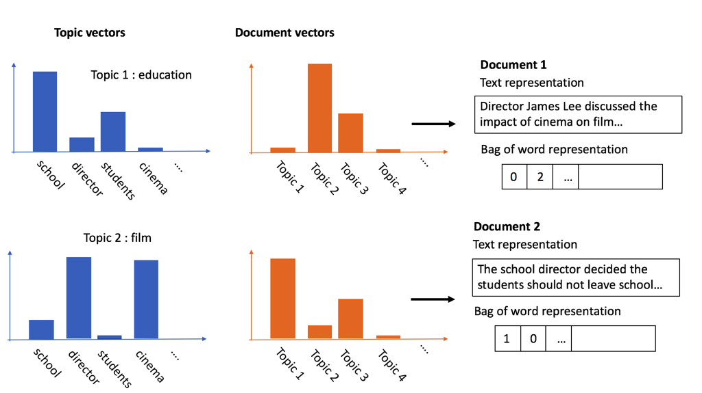

Slide 12
Installing gensim
On terminal, enter
pip install gensim
That's it!

Slide 13


Slide 14
gensim LDA
from gensim.models.ldamodel import LdaModel
from gensim import corpora doc1 = ['The', 'school', 'director', 'needs', 'reform'] doc2 = ['Director', 'discussed', 'impact', 'of', 'cinema']
list_of_documents = [doc1 , doc2]
lda_dict = corpora.Dictionary(list_of_documents)
dataset = []
for doc in list_of_documents:
dataset.append(lda_dict.doc2bow(doc))
model = LdaModel(corpus=dataset, num_topics=10, id2word=lda_dict)

Slide 15
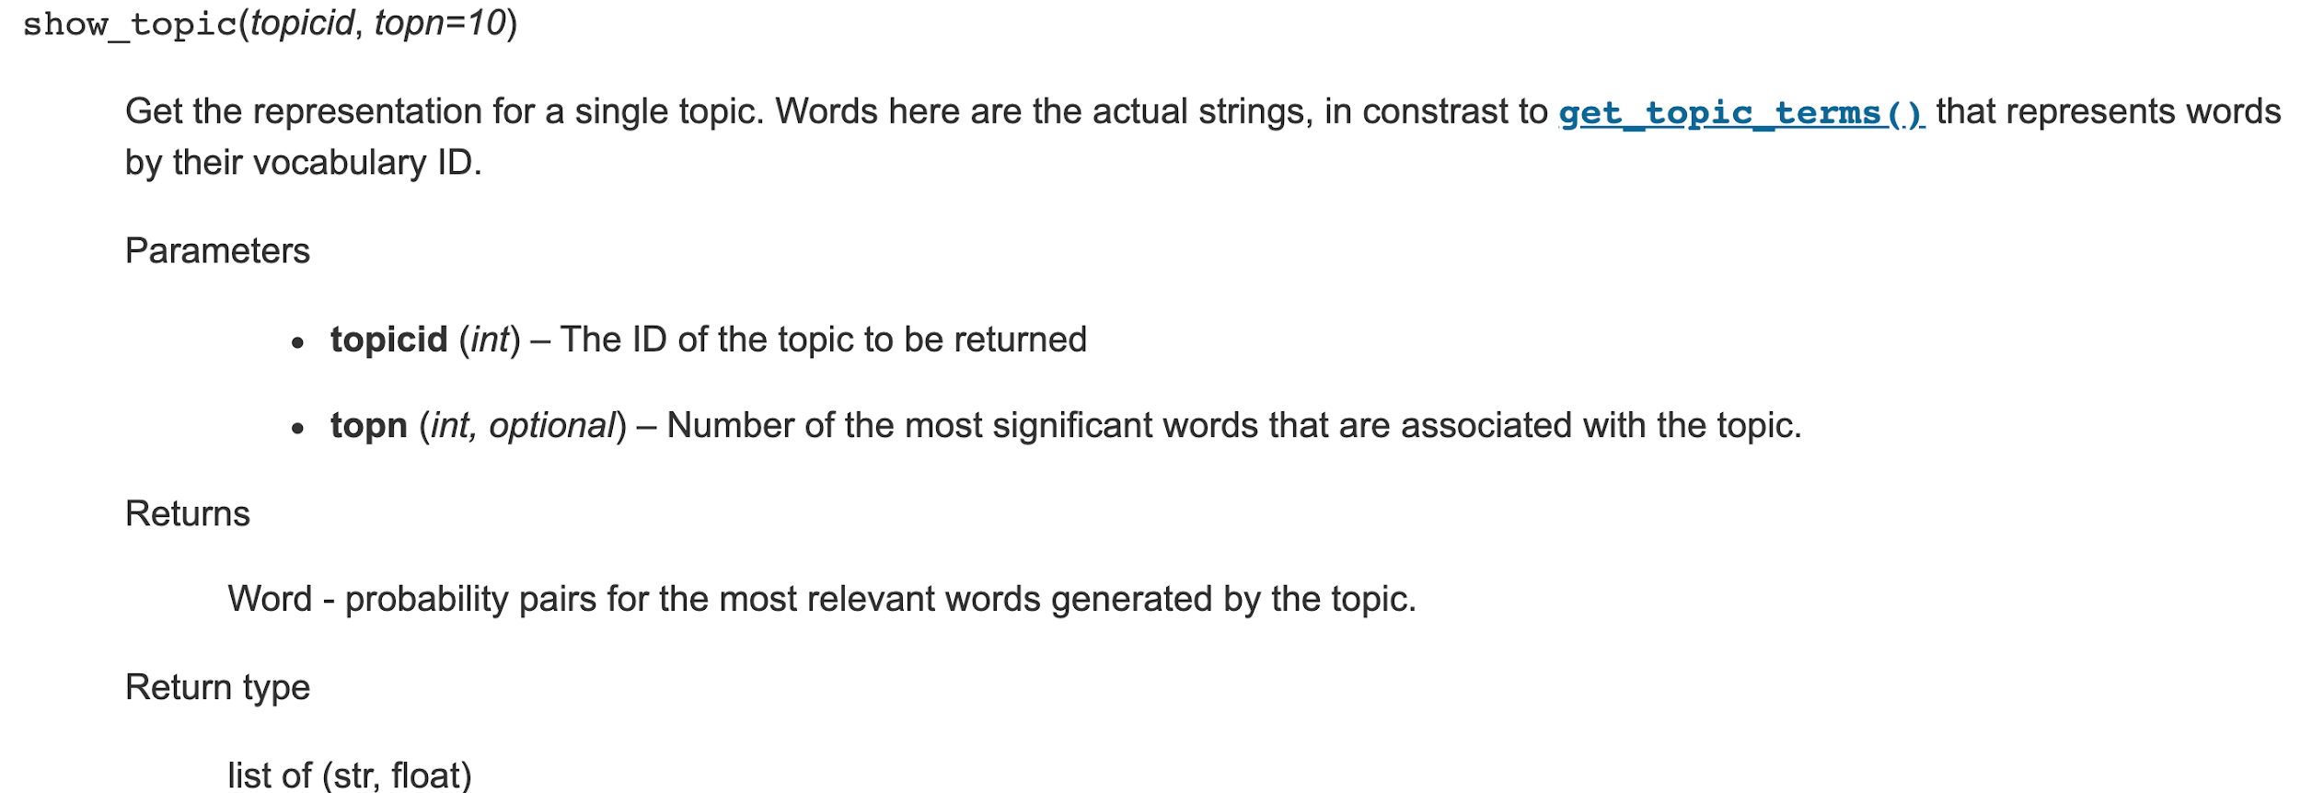
for topic_id in range(10):
print(model.show_topic(topic_id))

Slide 16
Mallet - Topic Modeling Tools

Slide 17
Why MALLET?
Implementation ของ LDA Topic Model ที่ถูกต้องครบถ้วนที่สุดในโลก และได้ผลออกมาดีที่สุด และเร็วที่สุด
ต้องรันบน Command Line
Windows = Powershell หรือ Anaconda Prompt
Mac = Terminal หรือ iterm

Slide 18
Download mallet
Download data wget http://www.cs.cornell.edu/people/pabo/movie-review-data/review_polarity.tar.gz
tar -xf review_polarity.tar.gz
Tokenize and convert data to mallet format mallet-2.0.8/bin/mallet import-dir --input txt_sentoken/neg --output topic-input.mallet --keep-sequence --remove-stopwords
Train model mallet-2.0.8/bin/mallet train-topics --input topic-input.mallet --xml-topic-report report.xml

Slide 19
Install MALLET
mkdir lda_exercise cd lda_exercise wget http://mallet.cs.umass.edu/dist/mallet-2.0.8.tar.gz tar -xf mallet-2.0.8.tar.gz
[WINDOWS powershell] $env:MALLET_HOME= absolute path ที่เก็บ mallet ลงท้ายด้วย/mallet-2.0.8/bin เช่น $env:MALLET_HOME=/Users/te/lda_exercise/mallet-2.0.8/bin

Slide 20
Download Data
wget http://www.cs.cornell.edu/people/pabo/movie-review-data/review_polarity.tar.gz tar -xf review_polarity.tar.gz

Slide 21
แปลงข้อมูลให้อยู่ในรูปแบบของ MALLET
mallet-2.0.8/bin/mallet import-dir --input โฟลเดอร์ที่มีข้อมูล --output ชื่อoutputfile --keep-sequence --remove-stopwords

Slide 22
Train Model
mallet-2.0.8/bin/mallet train-topics --input topic-input.mallet --xml-topic-report report.xml

Slide 23
mallet-2.0.8/bin/mallet train-topics --help
--xml-topic-report FILENAME
The filename in which to write the top words for each topic and any Dirichlet parameters in XML format. By default this is null, indicating that no file will be written.
Default is null
--xml-topic-phrase-report FILENAME
The filename in which to write the top words and phrases for each topic and any Dirichlet parameters in XML format. By default this is null, indicating that no file will be written.
Default is null --output-topic-docs FILENAME The filename in which to write the most prominent documents for each topic, at the end of the iterations. By default this is null, indicating that no file will be written. Default is null --output-doc-topics FILENAME The filename in which to write the topic proportions per document, at the end of the iterations. By default this is null, indicating that no file will be written Default is null

Slide 24
Tuning Model
mallet-2.0.8/bin/mallet train-topics --help
--num-topics INTEGER
The number of topics to fit.
Default is 10
--num-threads INTEGER
The number of threads for parallel training.
Default is 1
--optimize-interval INTEGER
The number of iterations between reestimating dirichlet hyperparameters.
Default is 0
--use-symmetric-alpha true|false
Only optimize the concentration parameter of the prior over document-topic distributions. This may reduce the number of very small, poorly estimated topics, but may disperse common words over several topics.
Default is false
--alpha DECIMAL
SumAlpha parameter: sum over topics of smoothing over doc-topic distributions. alpha_k = [this value] / [num topics]
Default is 5.0
--beta DECIMAL
Beta parameter: smoothing parameter for each topic-word. beta_w = [this value]
Default is 0.01

Slide 26
Exercise: Tuning Topic Model
ลองเปลี่ยนจำนวน thread ดูว่าเร็วขึ้นจริงมั้ย
ลองเปลี่ยนจำนวน Topic
เปลี่ยน optimize interval จาก 0 เป็น 10 หรือ 100

Slide 27
mallet-2.0.8/bin/mallet train-topics --input topic-input.mallet --num-threads 4 --num-topics 20 --xml-topic-phrase-report phrase_report.xml --optimize-interval 10 --use-symmetric-alpha false

Slide 28
LDA สำหรับข้อมูลภาษาไทย

Slide 29
ระวังเรื่อง Tokenization
mallet-2.0.8/bin/mallet import-dir --input โฟลเดอร์ที่มีข้อมูล --output ชื่อoutputfile --keep-sequence \ --token-regex "\p{L}+" \ --stoplist-file ไฟล์คำที่ไม่ต้องการ

